Slide 1
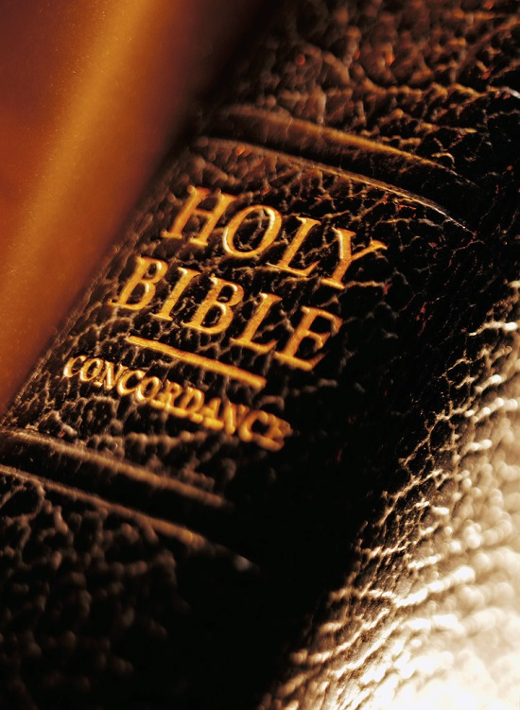
Expository
Excerpts
From Acts 2
(part 3; Acts 2:37-41)
All Verses Are From The NKJV Unless Noted

Slide 2
Acts 2 (previously)
2:1-11 – God Keeps His Promises
  Holy Spirit baptism
  Tongue speaking
2:12, 13 – Man’s Slow Heart
2:14-36 – The Defense Of The Gospel

Slide 3
The Importance Of The Resurrection
Acts 2:31

Slide 4
The Importance Of The Resurrection
“For You will not leave my soul in Hades, Nor will You allow Your Holy One to see corruption” (Acts 2:27; cf. 2:31)
The soul goes to “Hades” (the unseen)
The body goes to corruption (Gen. 3:19)
Many skip “hades” and teach that heaven is rewarded when a saint dies
  This defies the example of Jesus
  This denies the clear teaching of scripture
  This diminishes the need for the resurrection

Slide 5
The Importance Of The Resurrection
“For You will not leave my soul in Hades, Nor will You allow Your Holy One to see corruption” (Acts 2:27; cf. 2:31)
“Soul” and “body” are emphasized
The soul without the body is not fit for work
  A body prepared for Him to do the work of God (Heb. 10:5-7)
  Work while it is day; night comes when no one can work (Jn. 9:4)

Slide 6
The Importance Of The Resurrection
“For You will not leave my soul in Hades, Nor will You allow Your Holy One to see corruption” (Acts 2:27; cf. 2:31)
Jesus went to Hades when He died
  “And Jesus said to him, ‘Assuredly, I say to you, today you will be with Me in Paradise’” (Lk. 23:43)
  “So it was that the beggar died, and was carried by the angels to Abraham’s bosom. The rich man also died and was buried. And being in torments in Hades, he lifted up his eyes and saw Abraham afar off, and Lazarus in his bosom” (Lk. 16:22, 23)

Slide 7
The Importance Of The Resurrection
“For You will not leave my soul in Hades, Nor will You allow Your Holy One to see corruption” (Acts 2:27; cf. 2:31)
Without the bodily resurrection of Jesus:
  No fulfilled prophecy (Ps. 16:10)
  Work of redemption is incomplete (Rom. 4:25; 1 Cor. 15:17)
  Holy Spirit not sent (Jn. 15:26)
  No New Testament written (Acts 2:33; Jn. 16:13, 14)
  No mediation from heaven (Heb. 4:14, 15; 8:1-4)
  No living hope (1 Pet. 1:3)
  No resurrection of the dead to judgment (Acts 17:30, 31; 24:15; Jn. 5:28, 29)
  No reward at His coming (2 Tim. 4:8; Jn. 14:2, 3)

Slide 8
1 Corinthians 15:12-20
¹² Now if Christ is preached that He has been raised from the dead, how do some among you say that there is no resurrection of the dead?
¹³ But if there is no resurrection of the dead, then Christ is not risen.
¹⁴ And if Christ is not risen, then our preaching is empty and your faith is also empty.
¹⁵ Yes, and we are found false witnesses of God, because we have testified of God that He raised up Christ, whom He did not raise up—if in fact the dead do not rise.

Slide 9
1 Corinthians 15:12-20
¹⁶ For if the dead do not rise, then Christ is not risen.
¹⁷ And if Christ is not risen, your faith is futile; you are still in your sins!
¹⁸ Then also those who have fallen asleep in Christ have perished.
¹⁹ If in this life only we have hope in Christ, we are of all men the most pitiable.
²⁰ But now Christ is risen from the dead, and has become the firstfruits of those who have fallen asleep.

Slide 10

4) The Desired Effect And Plan For Pardon (2:37-41)
Cut to the heart (2:37)
  REACTION #1:
  cut to the heart with guilt; inquisitive for reconciliation
  REACTION #2:
  cut to the heart with anger; destroy the messenger
  (Acts 7:54; 5:33)

Slide 11
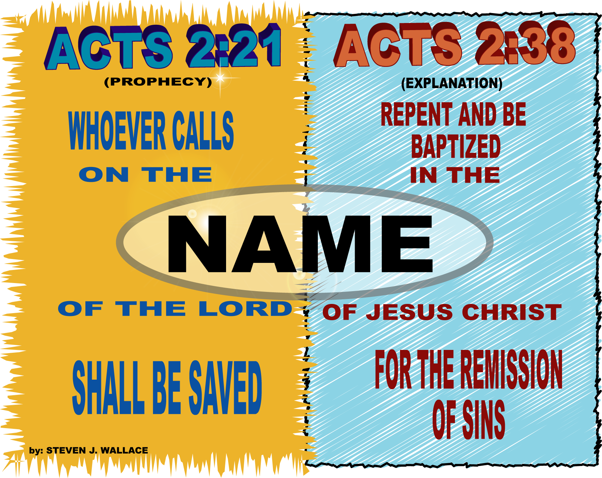
4) The Desired Effect And Plan For Pardon (2:37-41)
The clear answer (2:38-39)

Slide 12

4) The Desired Effect And Plan For Pardon (2:37-41)
The clear answer (2:38-39)
Opponents of this truth answer:
Gk. “eis” = “because of”
“For The Remission Of Sins”
“Because Of The Remission Of Sins”
=
Therefore they were to be baptized because they had the remission of sins!

Slide 13
Be careful not to slip on the “EIS”
Romans 10:10 believe (eis) righteousness
Rom. 10:10 confess (eis) salvation
Acts 11:18 repentance (eis) life
Acts 3:19 repent & be converted (eis) sins blotted out
Matthew 26:26 blood shed (eis) remission of sins

Slide 14
ACTS 2
21 “And it shall come to pass that whoever calls on the name of the LORD shall be saved.”
HOW?
37 Now when they heard this, they were cut to the heart, and said to Peter and the rest of the apostles, "Men and brethren, WHAT shall we do?"
38 Then Peter said to them, “REPENT, and let every one of you be BAPTIZED in the name of Jesus Christ for the remission of sins; and you shall receive the gift of the Holy Spirit.

Slide 15
PAUL – Calling On The Name Of The Lord
Paul preached it (Rom. 10:9-14)
Paul had not “called on the name of the Lord” when he called out the name of the Lord (Acts 9:4-6)
Paul had not “called on the name of the Lord” when he prayed and fasted (Acts 9:9, 11)
Paul called on the name of the Lord when he was baptized (Acts 22:16)

